Slide 1
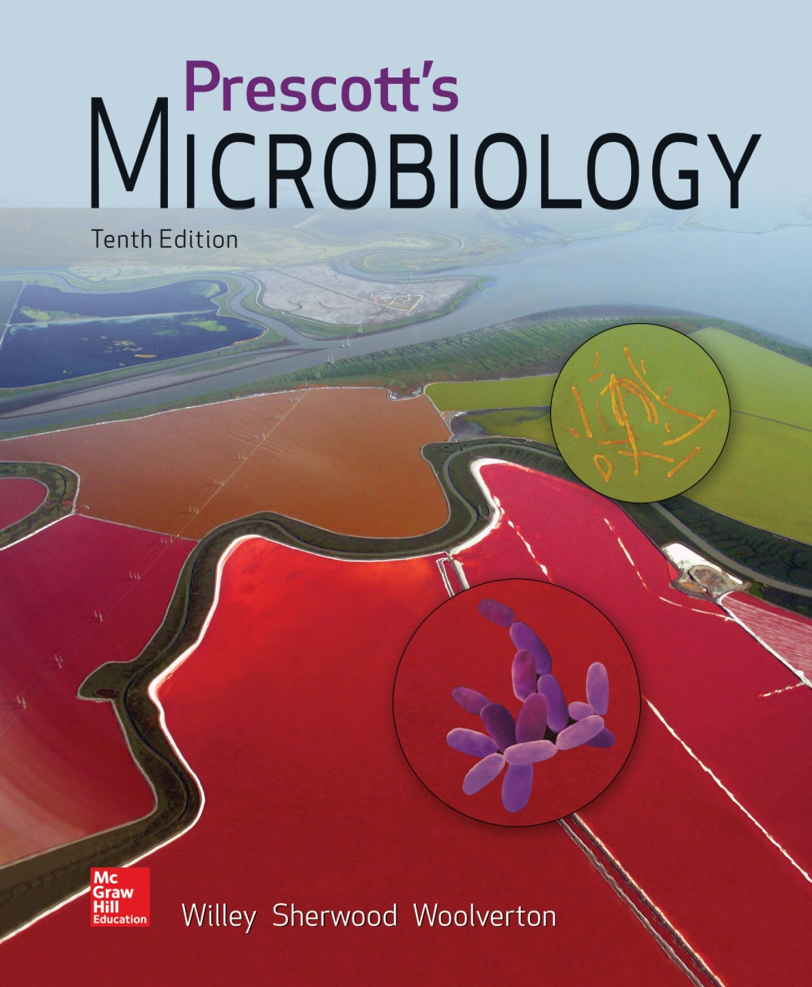
Chapter 6 – Viruses and Other Acellular Infectious Agents

Slide 2
6.1 Viruses are Acellular
Defines the terms virology, bacteriophages, and phages.
List organisms that are hosts to viruses.

Slide 3
Acellular Agents
Viruses – protein and nucleic acid
Viroids – only RNA
Satellites – only nucleic acids
Prions – proteins only

Slide 4
Viruses
Major cause of disease
also importance as a new source of therapy
new viruses are emerging
Important members of aquatic world
move organic matter from particulate to dissolved
Important in evolution
transfer genes between bacteria, others
Important model systems in molecular biology

Slide 5
General Properties of Viruses
Virion – complete virus particle
consists of ≥1 molecule of DNA/RNA in protein coat
may have additional layers
cannot reproduce independent of living cells nor carry out cell division
but can exist extracellularly

Slide 6
Virions Infect All Cell Types
Bacterial viruses called bacteriophages (phages)
Few archaeal viruses
Most are eukaryotic viruses
plants, animals, protists, and fungi
Classified into families based on
genome structure, life cycle, morphology, genetic relatedness

Slide 7
6.2 Virion Structure is Defined by Capsid Symmetry and Presence or Absence of an Envelope
State the size range of virions.
Identify the parts of a virion and describe their function.
Distinguish enveloped viruses from nonenveloped viruses.
Describe the types of capsid symmetry.

Slide 8
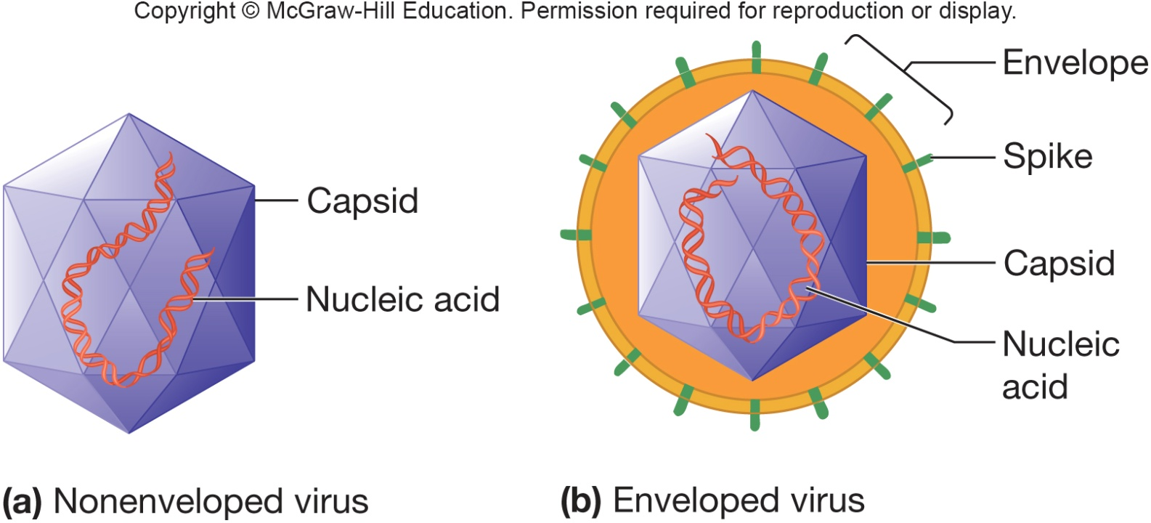
The Structure of Viruses
Virion size range is ~10–400 nm in diameter and most viruses must be viewed with an electron microscope
All virions contain a nucleocapsid which is composed of nucleic acid (DNA or RNA) and a protein coat (capsid)
some viruses consist only of a nucleocapsid, others have additional components
Envelopes

Slide 9
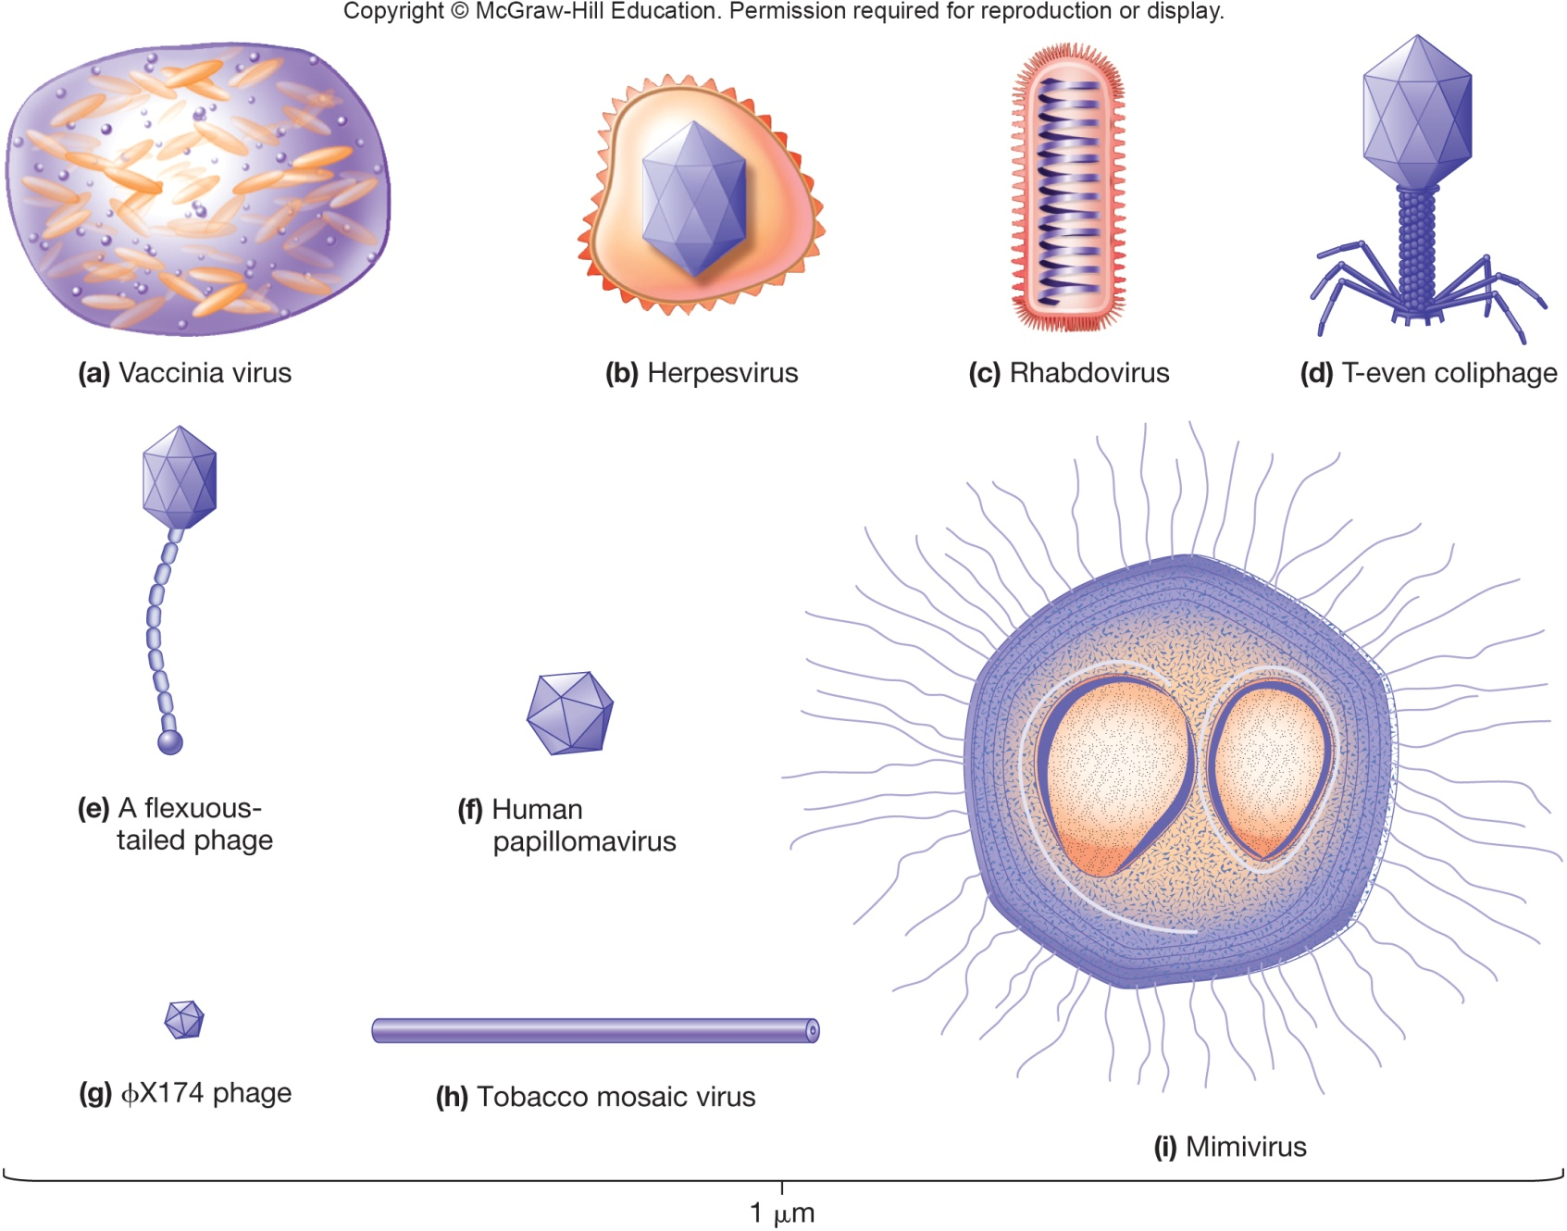
Size and Morphology of Select Viruses

Slide 10
Capsids
Large macromolecular structures which serve as protein coat of virus
Protect viral genetic material and aids in its transfer between host cells
Made of protein subunits called protomers
Capsids are helical, icosahedral, or complex

Slide 11
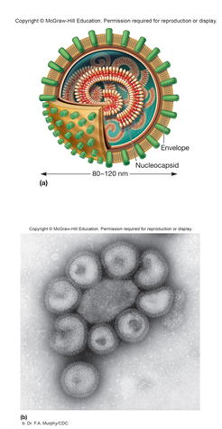
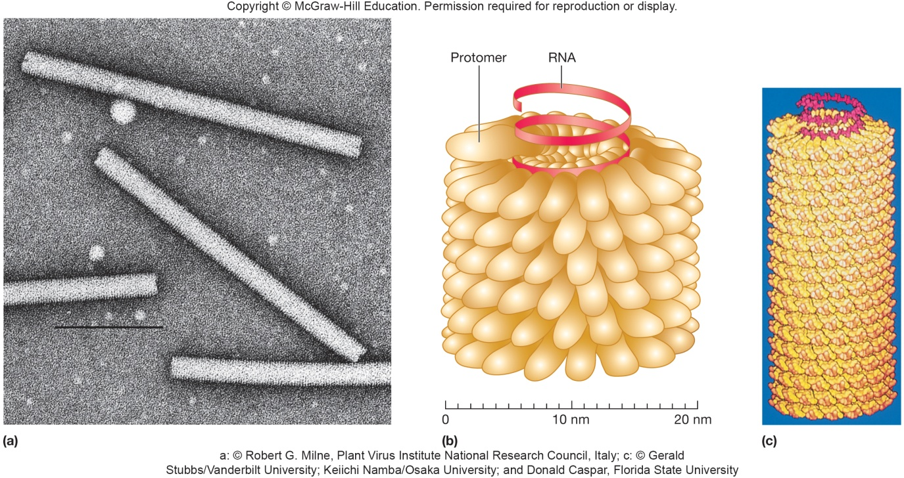
Helical Capsids Shaped like hollow tubes with protein walls Protomers self assemble Size of capsid is a function of nucleic acid

Slide 12
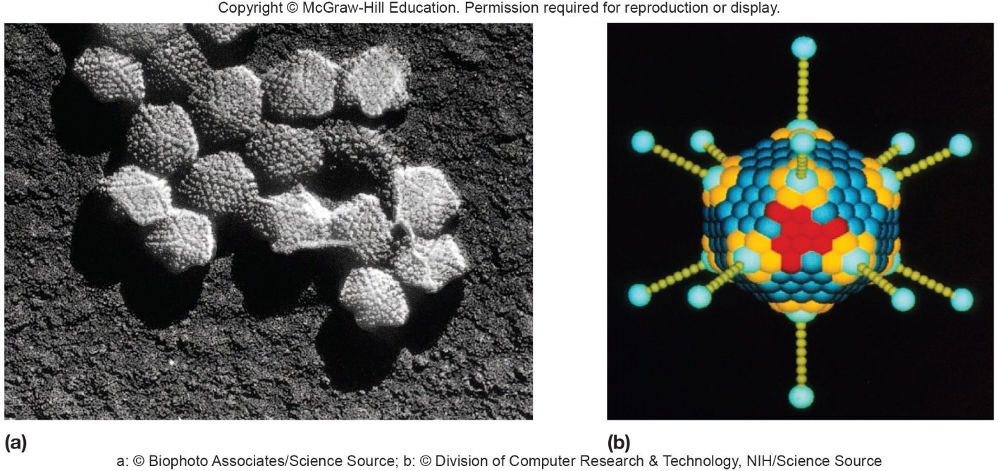
Icosahedral Capsids
An icosahedron is a regular polyhedron with 20 equilateral faces and 12 vertices
Capsomers
ring or knob-shaped units made of 5 or 6 protomers
pentamers (pentons) – 5 subunit capsomers
hexamers (hexons) – 6 subunit capsomers

Slide 13
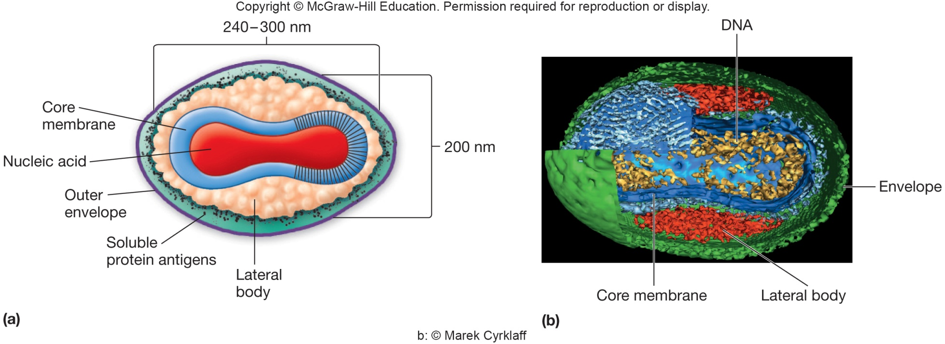
Capsids of Complex Symmetry
Some viruses do not fit into the category of having helical or icosahedral capsids
poxviruses – largest animal virus
large bacteriophages – binal symmetry
head resembles icosahedral, tail is helical

Slide 14
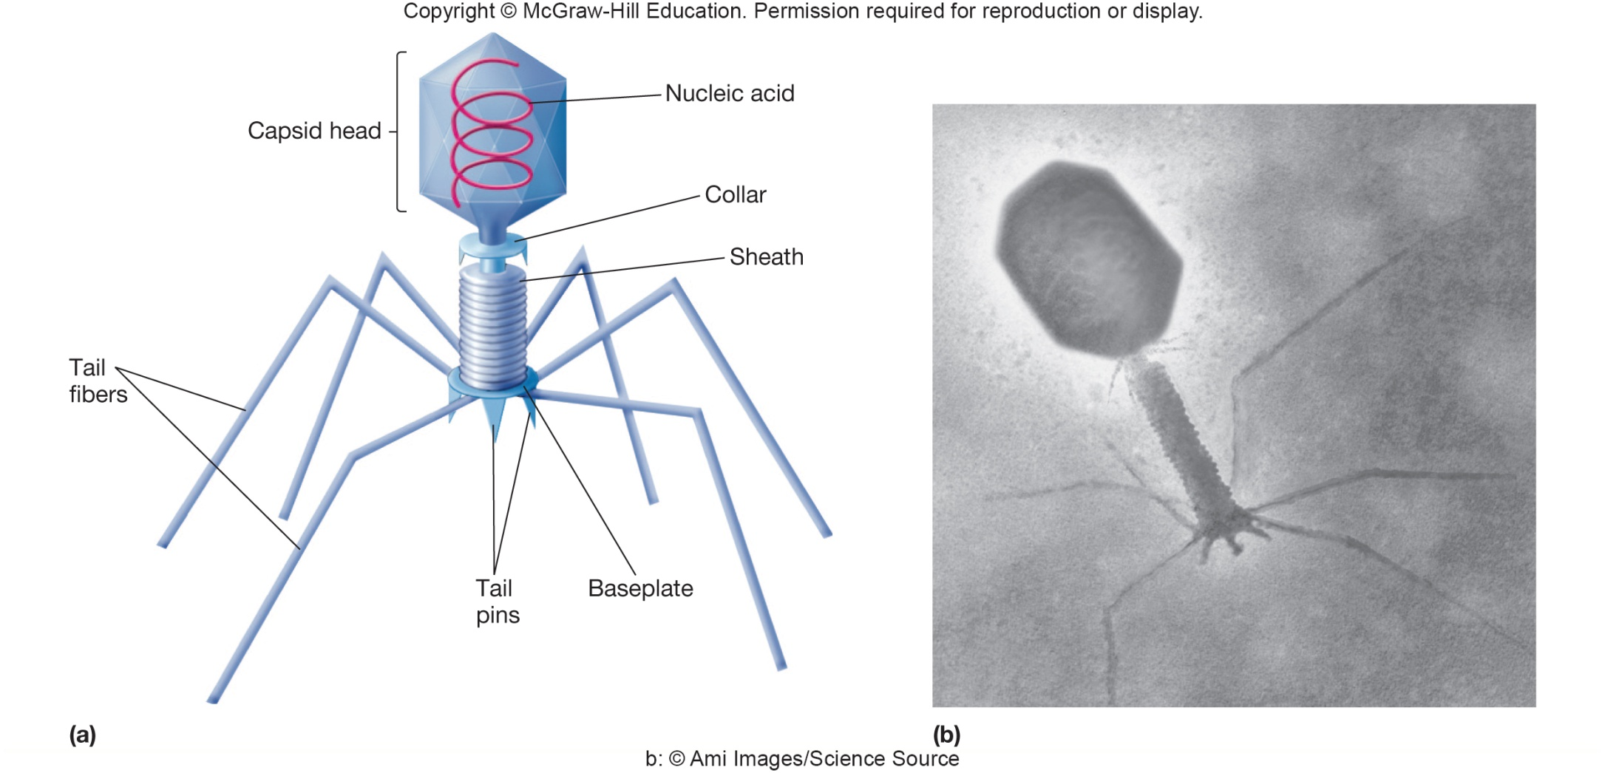
Phages: An Example of Complex Capsid Symmetry

Slide 15
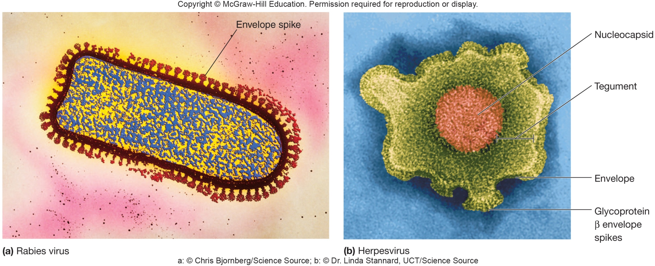
Viral Envelopes and Enzymes
Many viruses are bound by an outer, flexible, membranous layer called the envelope
Animal virus envelopes (lipids and carbohydrates) usually arise from host cell plasma or nuclear membranes

Slide 16
Viral Envelope Proteins
Envelope proteins, which are viral encoded, may project from the envelope surface as spikes or peplomers
involved in viral attachment to host cell
e.g., hemagglutinin of influenza virus
used for identification of virus
may have enzymatic or other activity
e.g., neuraminidase of influenza virus
may play a role in nucleic acid replication

Slide 17
Virion Enzymes
First erroneously thought that all virions lacked enzymes
Now accepted that a variety of virions have enzymes
some are associated with the envelope or capsid but most are within the capsid

Slide 18
Viral Genome
Diverse nature of genomes
A virus may have single or double stranded DNA or RNA
The length of the nucleic acid also varies from virus to virus
Genomes can be segmented or circular

Slide 19
6.3 Viral Life Cycles Have Five Steps
Describe the five steps common to the life cycles of all viruses.
Discuss the role of receptors, capsid proteins, and envelope proteins in the life cycles of viruses.
Describe the two most common methods for virion release from a host cell.

Slide 20
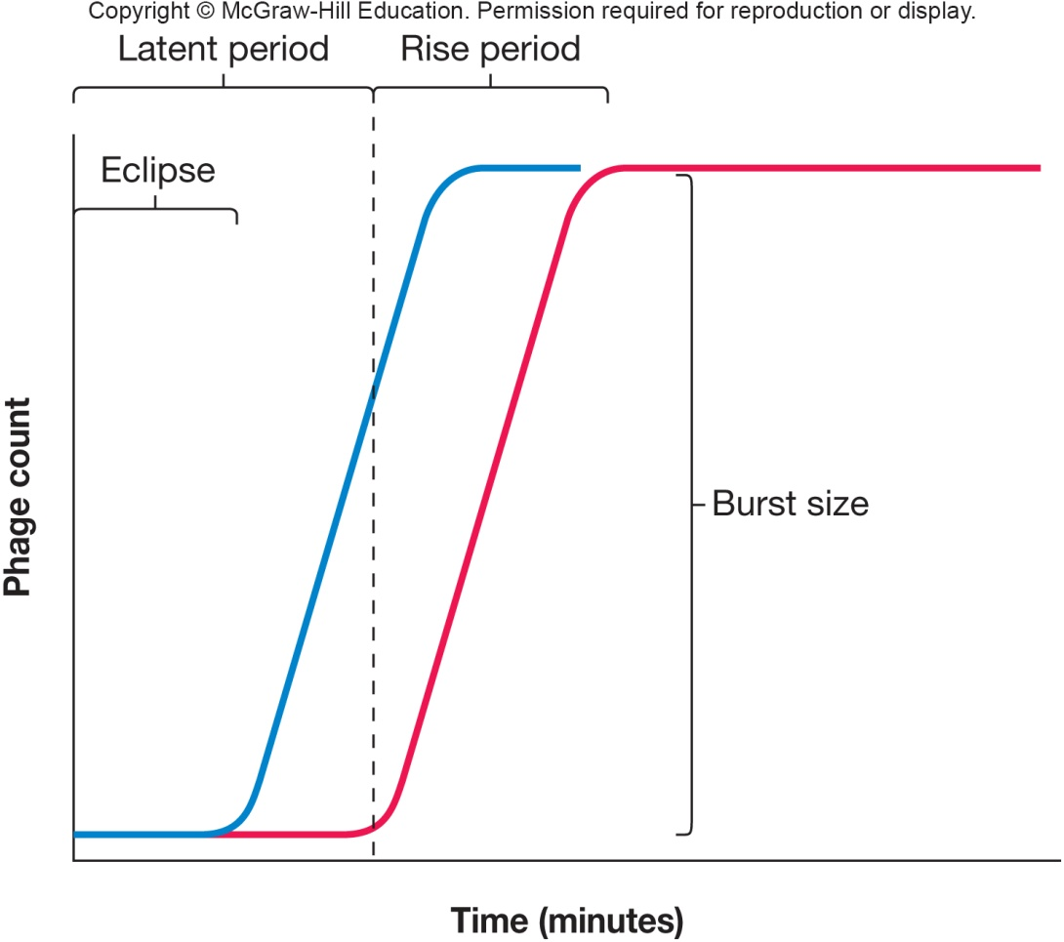
One-Step Growth Curves
Early experiments in 1939 by Delbruck and Ellis with bacteriophage T4 and E. coli host cells
illustrated an eclipse period where no new virus was present in host cells
also showed burst size – the number of new viruses produced per infected cell
First steps and evidence to understanding viral life cycle steps

Slide 21
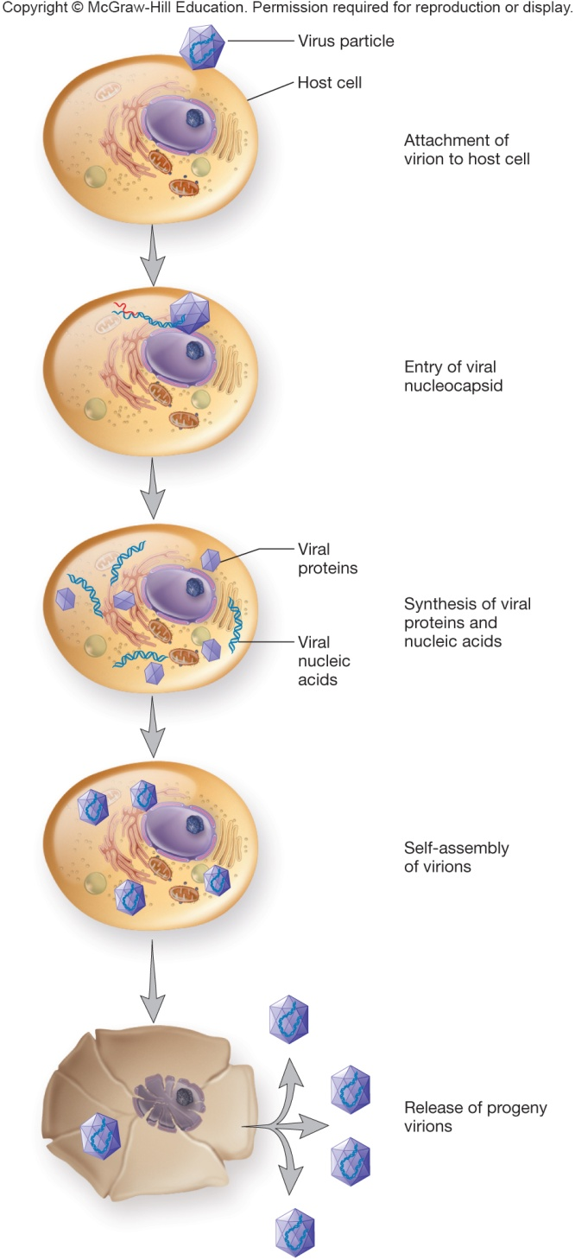
Viral Multiplication
Mechanism used depends on viral structure and genome
Steps are similar
attachment to host cell
entry and uncoating of genome
synthesis
assembly
release

Slide 22
Attachment (Adsorption)
Specific receptor attachment
Receptor determines host preference
may be specific tissue (tropism)
may be more than one host
may be more than one receptor
may be in lipid rafts providing entry of virus

Slide 23
Viral Entry and Uncoating
Entire genome or nucleocapsid
Varies between naked or enveloped virus
Three methods used
fusion of the viral envelope with host membrane; nucleocapsid enters
endocytosis in vesicle; endosome aids in viral uncoating
injection of nucleic acid

Slide 24
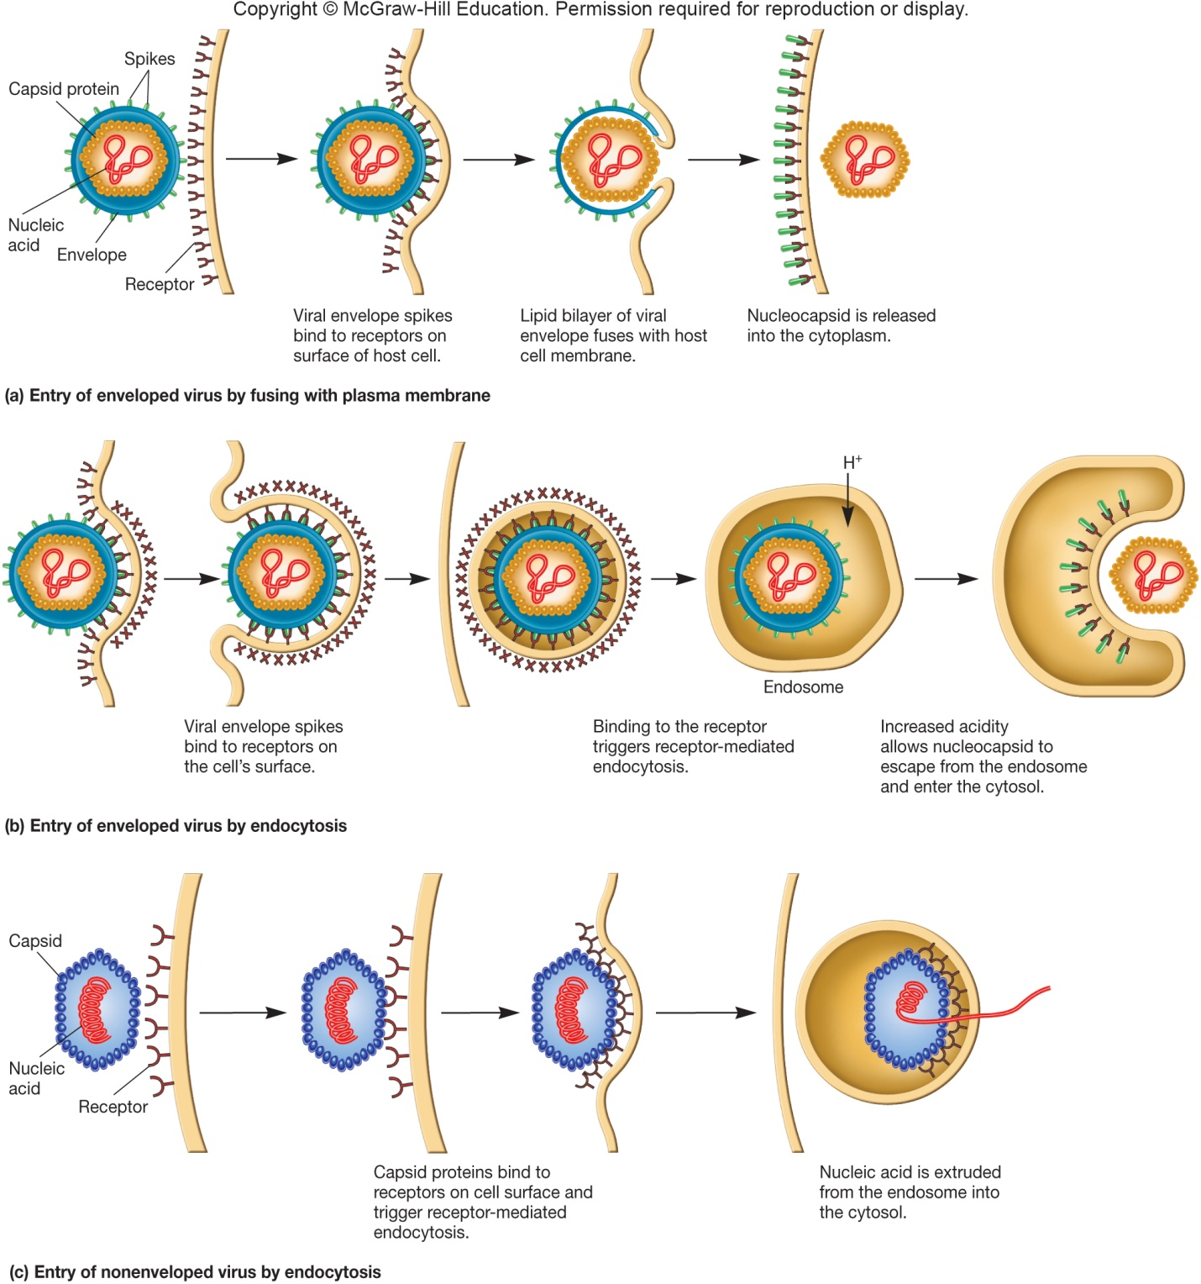
Animal Virus Entry Mechanisms

Slide 25
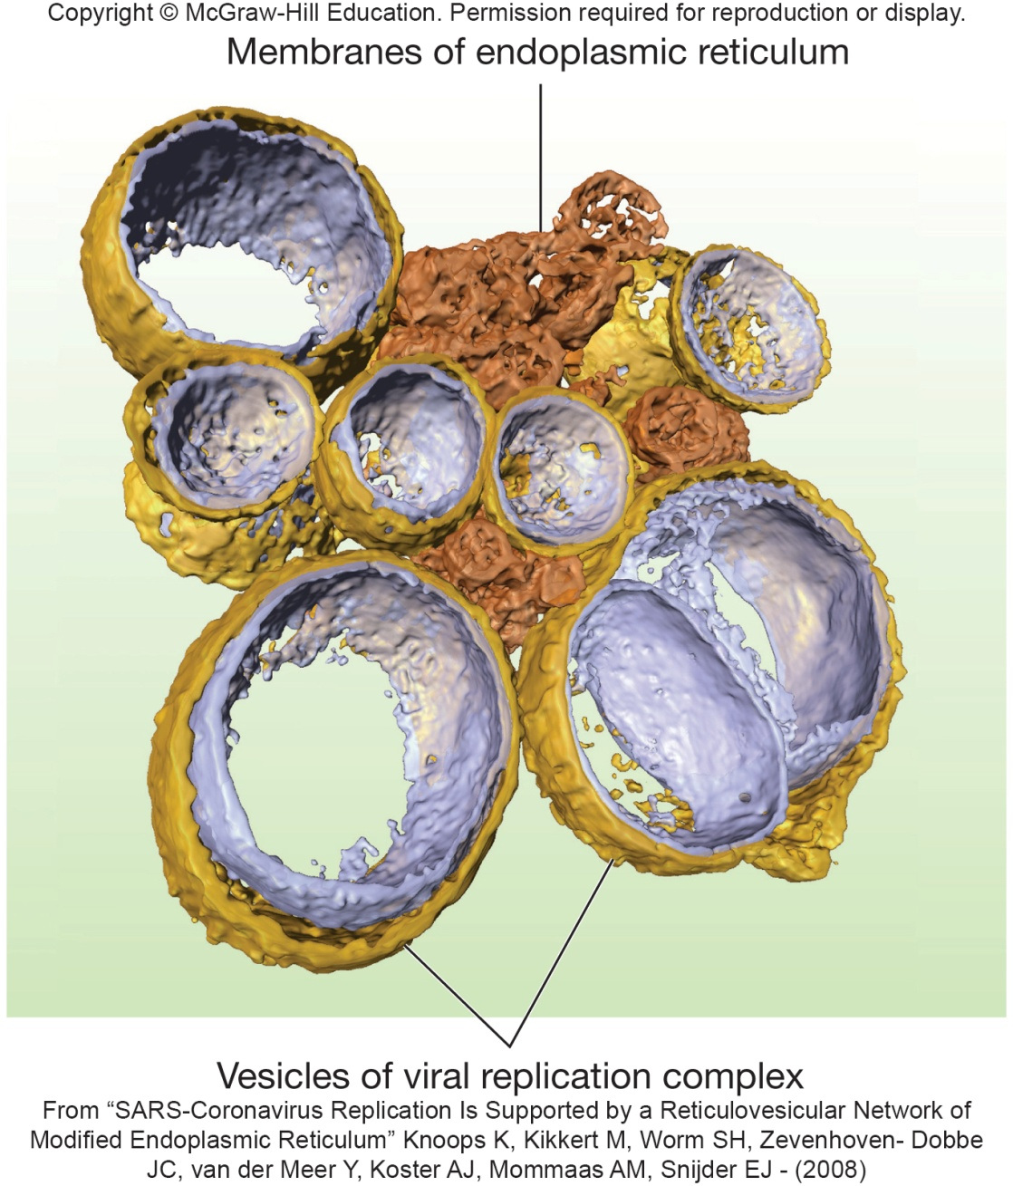
Synthesis Stage
Genome dictates the events
ds DNA typical flow
RNA viruses
virus must carry in or synthesize the proteins necessary to complete synthesis
Stages may occur, e.g.,
early and late
May induce formation of
membrane-protected
replication complexes

Slide 26
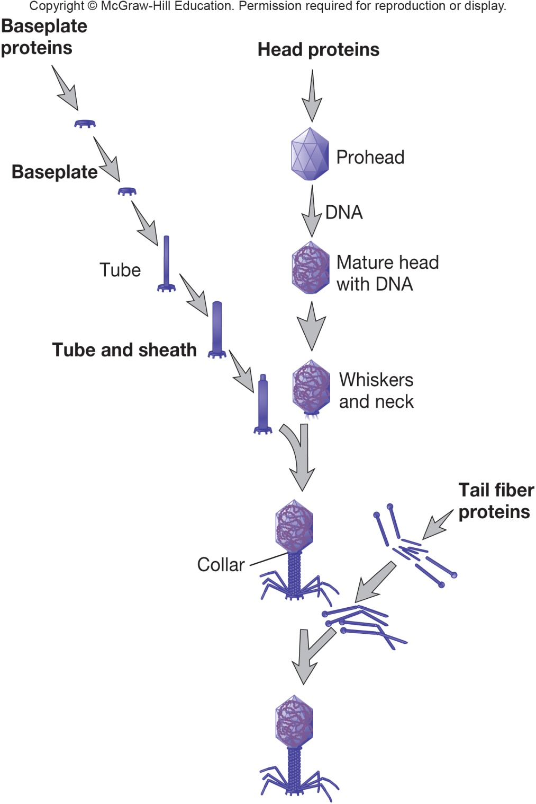
Assembly
Late proteins are important in assembly
Assembly is complicated but varies
bacteriophages – stages
some are assembled in nucleus
some are assembled in cytoplasm
may be seen as paracrystalline structures in cell

Slide 27
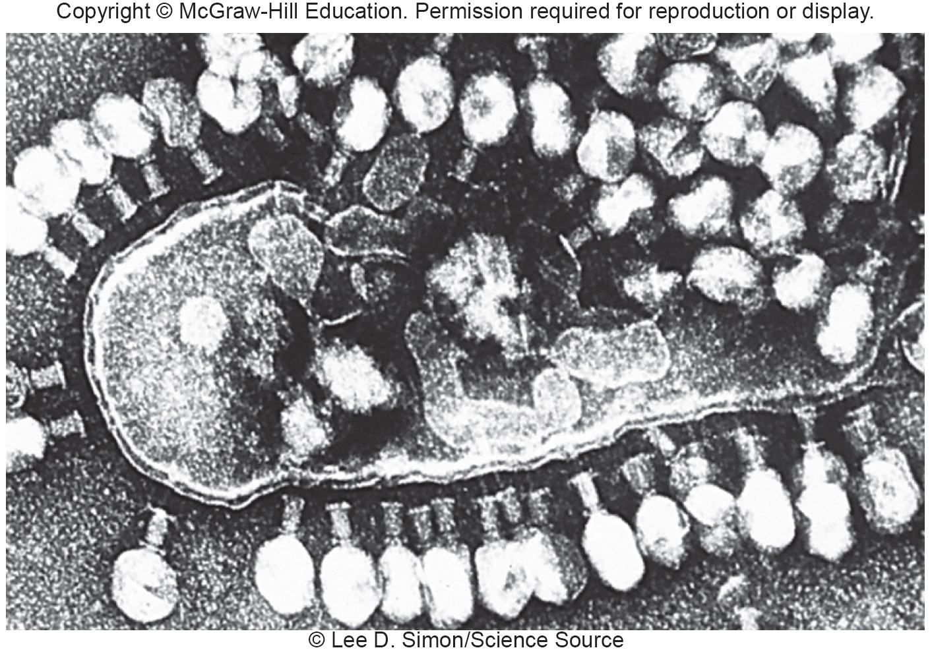
Virion Release
Nonenveloped viruses lyse the host cell
viral proteins may attack peptidoglycan or membrane

Slide 28
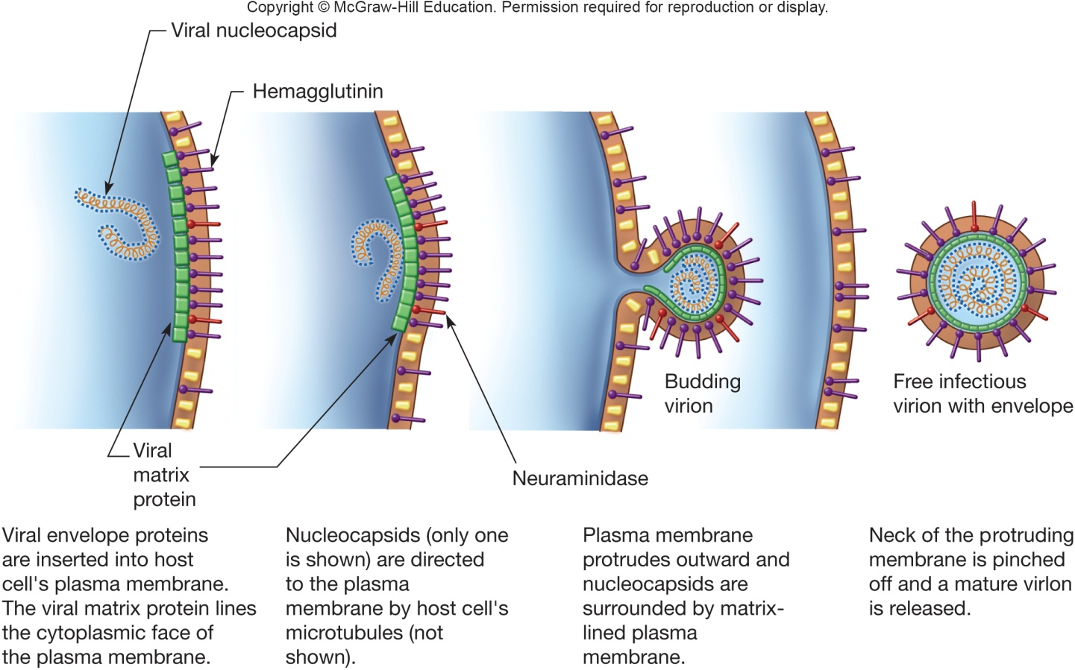
Virion Release (2)
Enveloped viruses use budding
viral proteins are placed into host membrane
nucleocapsid may bind to viral proteins
envelope derived from host cell membrane, but may be Golgi, ER, or other
virus may use host actin tails to propel through host membrane

Slide 29
6.4 There Are Several Types of Viral Infections
Compare and contrast the major steps of the life cycles of virulent phages and temperate phages.
List examples of lysogenic conversion.
Differentiate among the types of viral infections of eukaryotic cells.
Summarize the current understanding of how oncoviruses cause cancer.

Slide 30
Bacterial and Archaeal Viral Infections
Virulent phage – one reproductive choice
multiplies immediately upon entry
lyses bacterial host cell
Temperate phages have two reproductive options
reproduce lytically as virulent phages do
remain within host cell without destroying it
many temperate phages integrate their genome into host genome (becoming a ‘prophage’ in a ‘lysogenic bacterium’) in a relationship called lysogeny

Slide 31
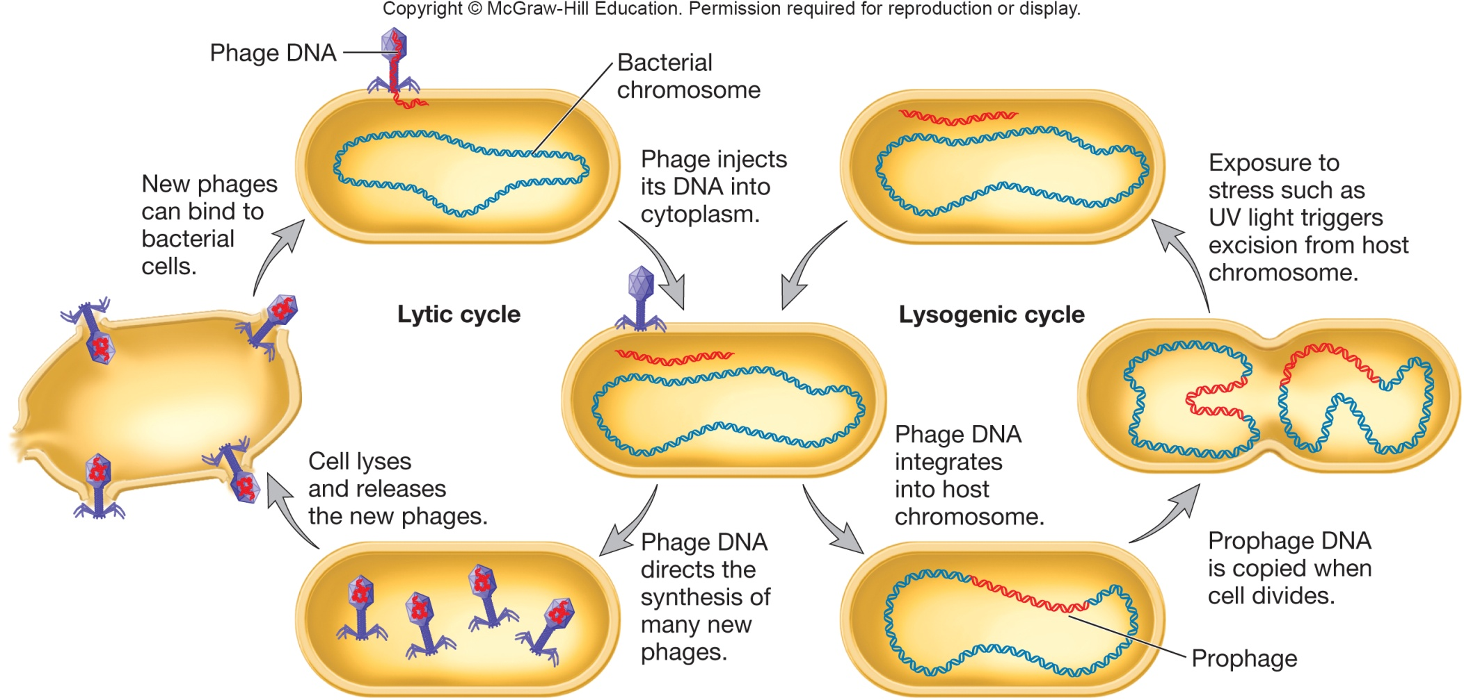
Lytic and Lysogenic Cycles

Slide 32
Lysogenic Conversion
Temperate phage changes phenotype of its host
bacteria become immune to superinfection
phage may express pathogenic toxin or enzyme
Two advantages to lysogeny for virus
phage remains viable but may not replicate
multiplicity of infection ensures survival of host cell
Under appropriate conditions infected bacteria will lyse and release phage particles
occurs when conditions in the cell cause the prophage to initiate synthesis of new phage particles, a process called induction

Slide 33
Archaeal Viruses
May be lytic or temperate
Most discovered so far are temperate by unknown mechanisms

Slide 34
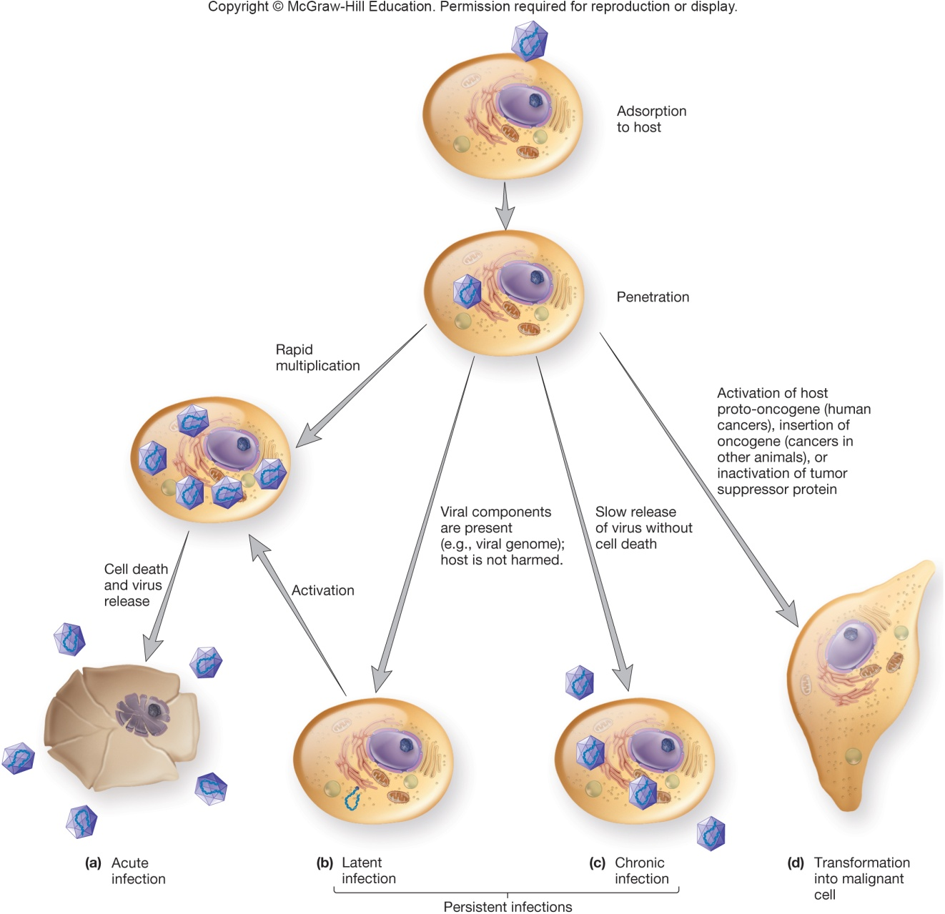
Infection in Eukaryotic Cells
Cytocidal infection results in cell death through lysis
Persistent infections may last years
Cytopathic effects (CPEs)
degenerative changes
abnormalities
Transformation to malignant cell

Slide 35
Viruses and Cancer
Tumor
growth or lump of tissue;
benign tumors remain in place
Neoplasia
abnormal new cell growth and reproduction due to loss of regulation
Anaplasia
reversion to a more primitive or less differentiated state
Metastasis
spread of cancerous cells throughout body

Slide 36
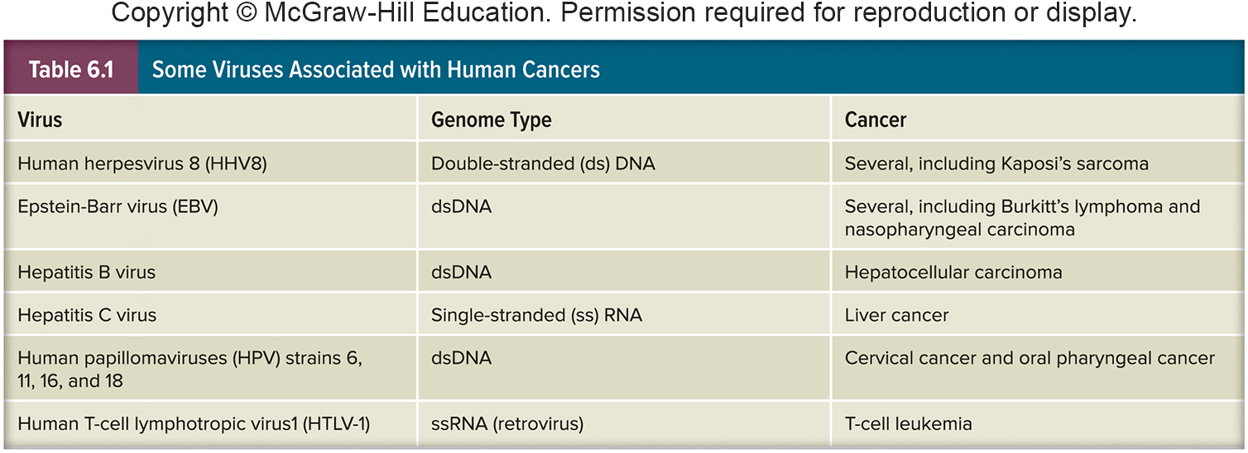
Carcinogenesis
Complex, multistep process
Often involves oncogenes
cancer causing genes
may come from the virus OR may be transformed host proto-oncogenes (involved in normal regulation of cell growth/differentiation)

Slide 37
Possible Mechanisms by Which Viruses Cause Cancer
Viral proteins bind host cell tumor suppressor proteins
Carry oncogene into cell and insert it into host genome
Altered cell regulation
Insertion of promoter or enhancer next to cellular oncogene

Slide 38
6.5 Cultivation and Enumeration of Viruses
List the types of approaches used to cultivate viruses, noting which types of viruses are cultivated by each method.
Describe three direct counting methods and two indirect counting methods used to enumerate viruses.
Outline the events that lead to the formation of a plaque in a lawn of bacterial cells.
Distinguish lethal dose from infectious dose.

Slide 39
The Cultivation of Viruses
Requires inoculation of appropriate living host
Hosts for Bacterial and Archael Viruses
Usually cultivated in broth or agar cultures of suitable, young, actively growing bacteria
Broth cultures lose turbidity as viruses reproduce
Plaques observed on agar cultures

Slide 40
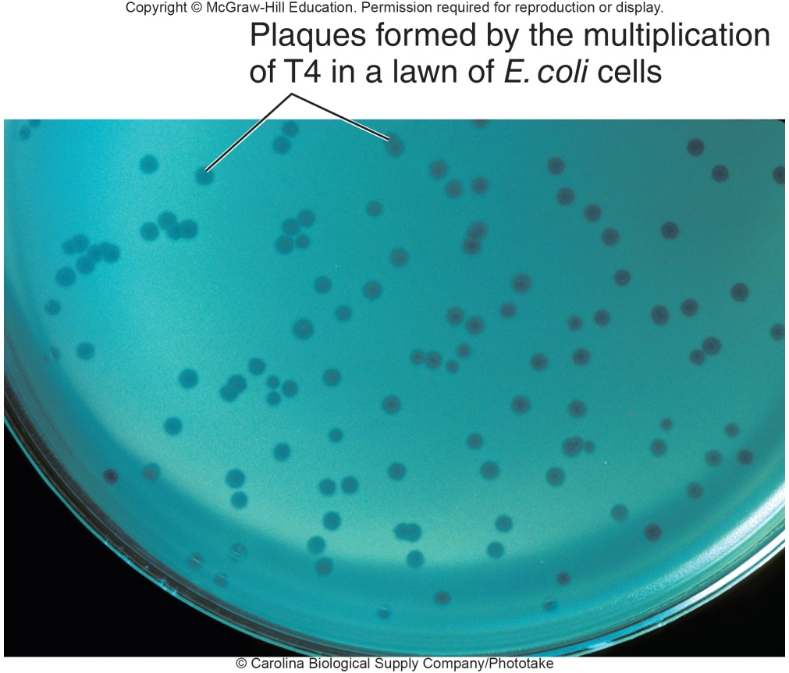
Hosts for Animal Viruses
Tissue (cell) cultures
cells are infected with virus (phage)
viral plaques
localized area of cellular destruction and lysis that enlarge as the virus replicates
Cytopathic effects (CPEs)
microscopic or macroscopic
degenerative changes or
abnormalities in host
cells and tissues
Embryonated eggs

Slide 41
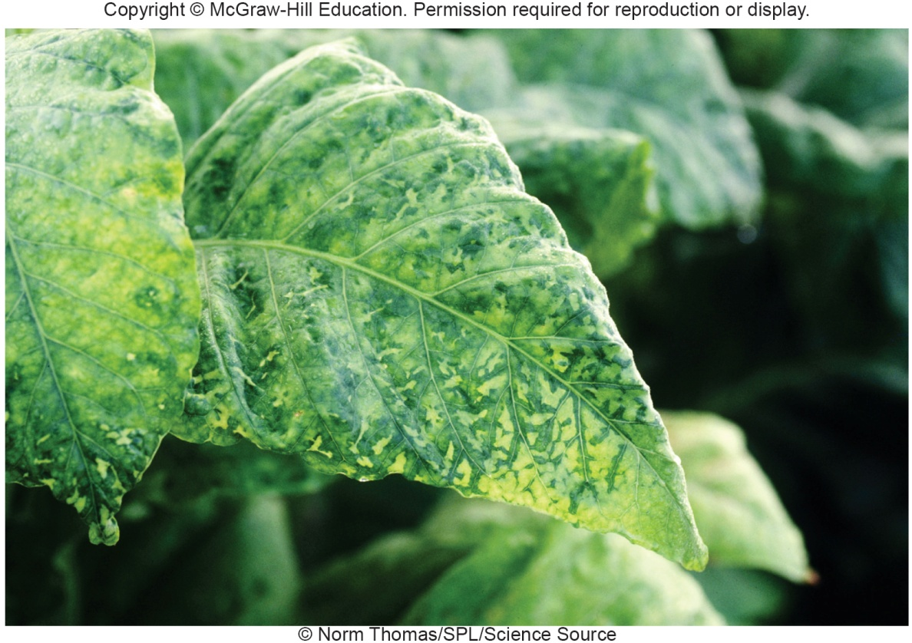
Hosts for Plant Viruses
Plant tissue cultures
Plant protoplast cultures
Suitable whole plants
may cause localized
necrotic lesions or
generalized symptoms
of infection

Slide 42
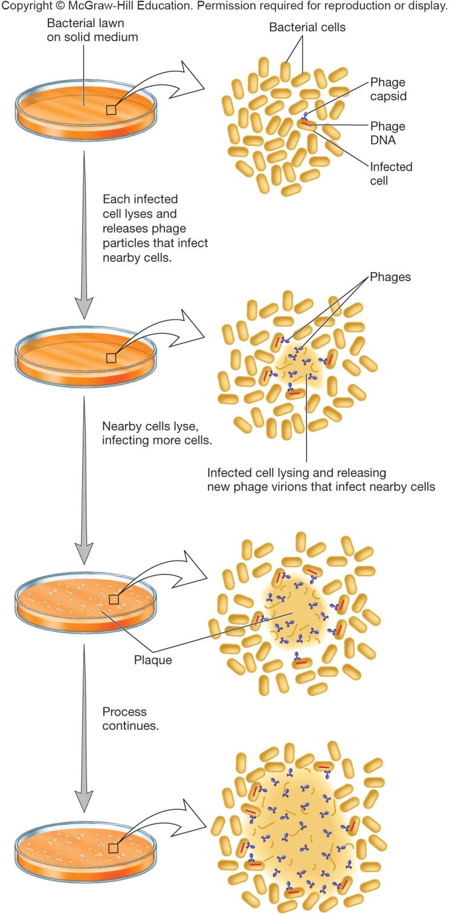
Quantification of Virus
Direct counting of viral particles
Indirect counting by an observable effect of the virus
hemagglutination assay
plaque assays
dilutions of virus preparation made and plated on lawn of host cells
number of plaques counted
results expressed as plaque-forming units (PFU) – plaque forming units (PFU)
PFU/ml = number of plaques/sample dilution

Slide 43
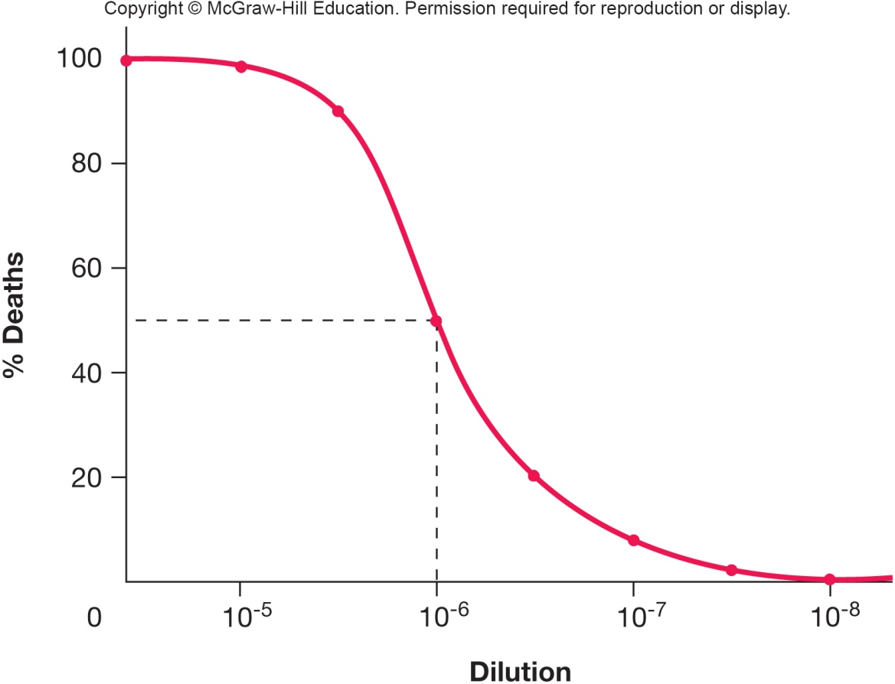
Measuring Biological Effects
Infectious dose and lethal dose assays
determine smallest amount of virus needed to cause infection (ID) or death (LD) of 50% of exposed host cells or organisms (ID₅₀ or LD₅₀)

Slide 44
6.6 Viroids and Satellites: Nucleic Acid-Based Subviral Agents
Describe the structure of a viroid and discuss the practical importance of viroids.
Distinguish satellite viruses from satellite nucleic acids.

Slide 45
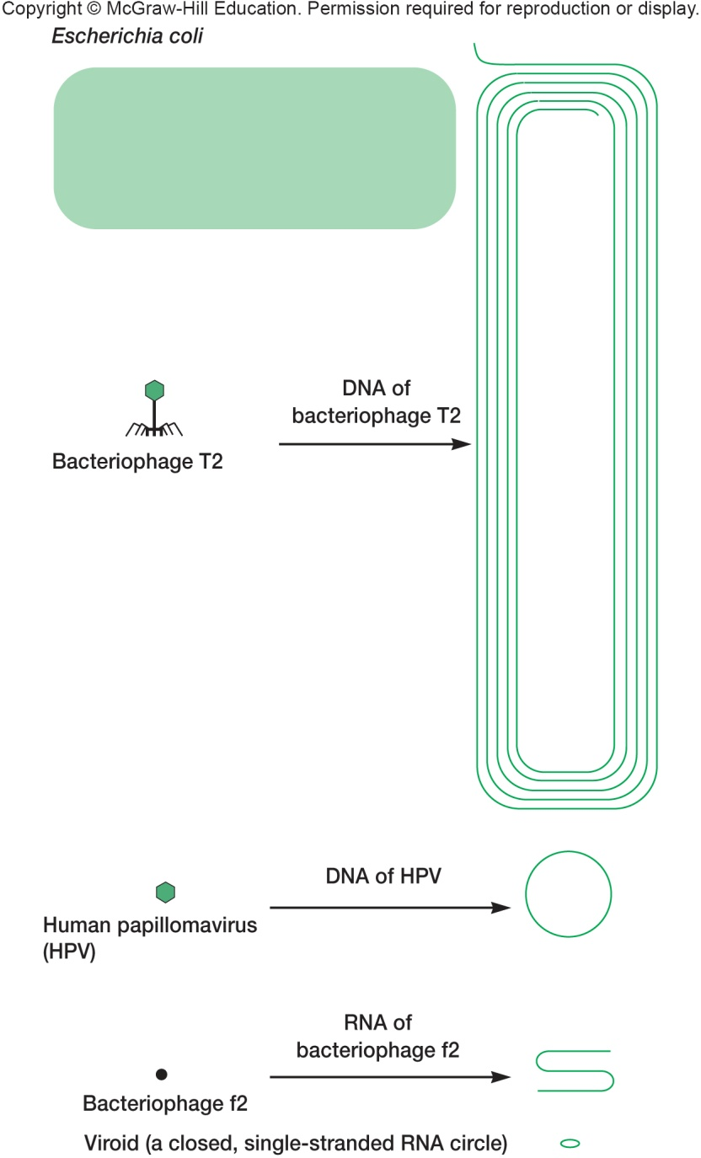
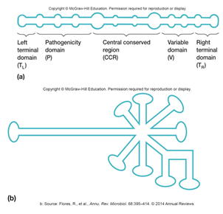
Viroids Infectious agents composed of closed, circular ssRNAs Do not encode gene products Replication requires host cell DNA-dependent RNA polymerase Cause plant diseases

Slide 46
Satellites
Infectious nucleic acids (DNA or RNA)
satellite viruses encode their own capsid proteins when helped by a helper virus
satellite RNAs/DNAs do NOT encode their own capsid proteins
Encode one or more gene products
Require a helper virus for replication
human hepatitis D virus is satellite
requires human hepatitis B virus

Slide 47
6.7 Prions Are Composed Only of Protein
Describe prion structure and how prions are thought to replicate.
List characteristics common to all animal diseases caused by prions.
Name at least two human diseases caused by prions.
Describe the mechanisms by which a prion protein might first appear in a brain cell.

Slide 48
Prions – Proteinaceous Infectious Particle
Cause a variety of degenerative diseases in humans and animals
scrapie in sheep
bovine spongiform encephalopathy (BSE) or mad cow disease
Creutzfeldt-Jakob disease (CJD) and variant CJD (vCJD) in humans
kuru in humans

Slide 49
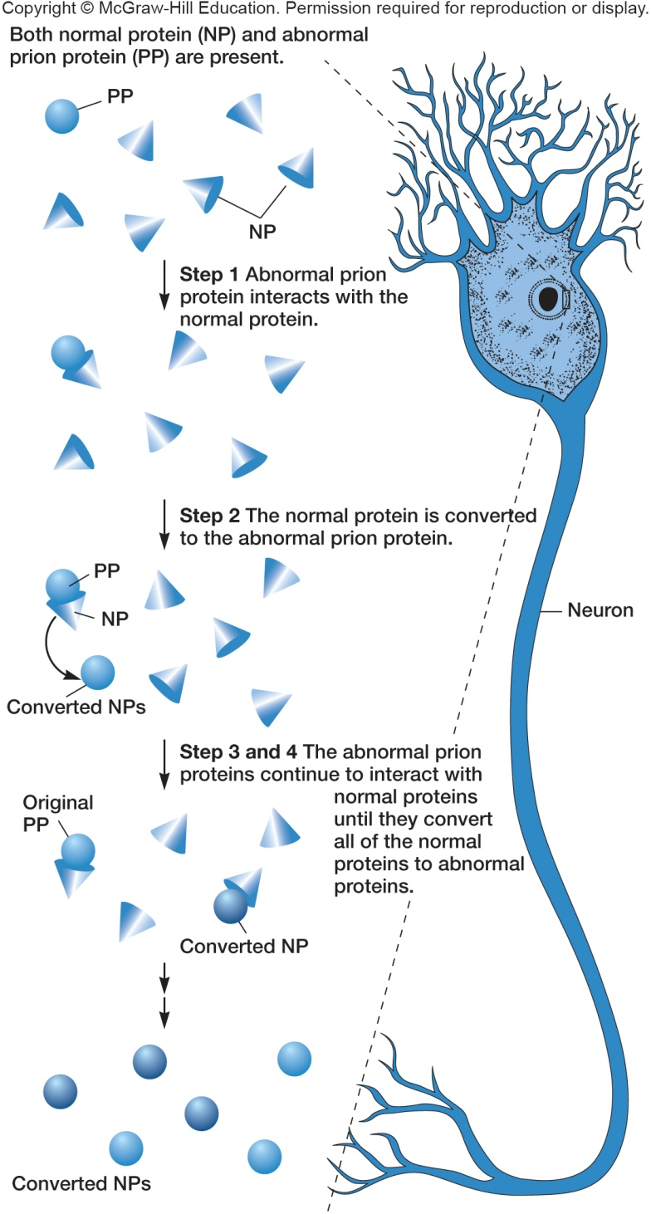
Current Model of Disease Production by Prions
PrP^{C} (prion protein) is present in “normal” form (abnormal form of prion protein is PrP^{Sc})
PrP^{Sc} causes PrP^{C} protein to change its conformation to abnormal form
Newly produced PrP^{Sc} molecules convert more normal molecules to the abnormal form through unknown mechanism

Slide 50
Neural Loss
Evidence suggests that PrP^{C} must be present for neural degeneration to occur
Interaction of PrP^{Sc} with PrP^{C} may cause PrP^{C} to crosslink and trigger apoptosis
PrP^{C} conversion causes neuron loss, PrP^{Sc} is the infectious agent
All prion caused diseases
have no effective treatment
result in progressive degeneration of the brain and eventual death

Slide 51
Take Home Message
This material is a complement to the chapters on the three Domains of life
The items in this chapter fall outside of the three Domains, but are very important members of the microbial world
Understand what each member of the acellular entities is, how they function, and how they replicate can round out your greater understanding of the microbial world
Try to think of how these entities fit into the overall scheme of microbes on Earth – how are they similar, how are they different

